Slide 1
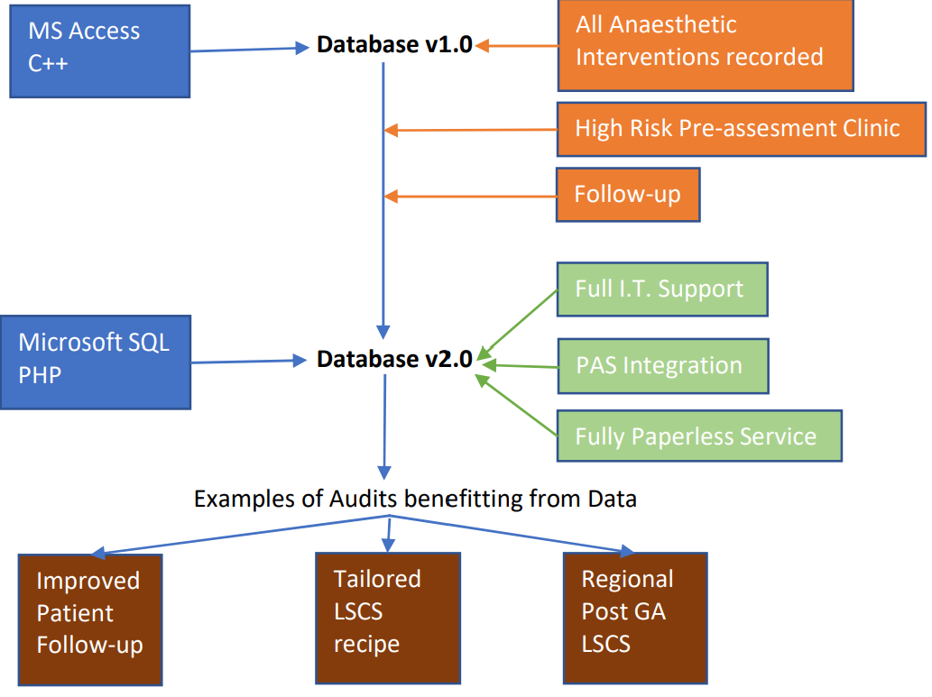
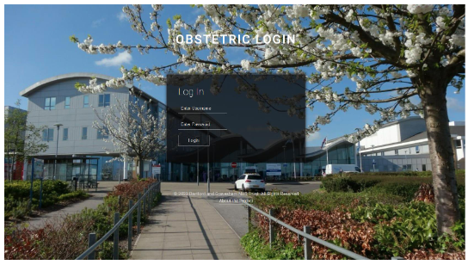
In-House Anaesthetic Database Development: Data Driven Care to Improve Patientcare
Lake, D¹., Vaithamanithi, R²., Oduyeye, B³., Jayakumari, A⁴. & Satisha, M⁵.
1. Anaesthetic Consultant, Darent Valley Hospital
2. Head of Clinical System Development, Darent Valley Hospital
3. Systems Developer, Darent Valley Hospital
4. Systems Developer, Darent Valley Hospital
5. Anaesthetic Consultant, Darent Valley Hospital
Introduction
Results
Discussion
In 2014 as an anaesthetic trainee with no prior coding knowledge I developed a database to record all the data of our anaesthetic interventions on delivery suite. This was to generally improve our record keeping, but also make the audit process easier by having all data available. Over the next 6 years I continued to maintain and develop this database, and implemented it in 2 different hospitals during my training rotations.
In 2020 this project had really reached its maximum potential with my limited I.T. knowledge, but thankful Darent Valley Hospital I.T. department took on the next phase and from the ground up created a new system which has not only allowed our department to achieve paperless state completely, it has also facilitated/enabled us to analyse the patient data for numerous QIP's and greatly improved patient care because of this.
The collection of accurate and easily accessible patient data has allowed our department to rapidly analyse data for multiple QIPs and quickly implement changes that improve patientcare. Examples of this have been significant improvements on patients follow-up and tailoring of elective LSCS anaesthetic recipe to best reduce PONV and maximise analgesia.
The full integration of this new application with the hospital PAS and clinical portal allows us to ensure no patient details are missed and all patient episodes formulate a fully digital form to record all the anaesthetic interventions and follow-up. The system automatically generates and stores the patients notes digitally. This enables us to be completely paperless and brought obvious improvements in our departments sustainability. Also ensures that patient records are available as and when needed and doesn’t get lost.
Collection and analysis of the Data is key to improve the service we deliver to our patients and to find individual anaesthetic techniques that offers more benefits. System has enabled clinicians to carry out Multiple departmental audits efficiently using this data and also has been greatly beneficial in departmental inspections such as the CQC visit. The promptness and quality of the data (for example minutes waited till epidural insertion) were even commented on and praised in the CQC appraisal.
All departments are offering these anaesthetic services, yet they have to collect the data in a way that allows them to analyse easily which is fundamental to promptly review and implement changes rapidly in order to improve the care we provide to our patients.
Many anaesthetic departments have purchased off the shelf applications for this purpose, but an advantage of having the In-House solution allows to promptly change and improve the way data is collected without any financial implication that an off the shelf software solution would demand, if they offered a tailored solution at all.
Method
With the Trust I.T. department working together with the obstetric anaesthetic department we managed to create a web based application that had full PAS integration and the ability to generate an e-document at the end of each patient episode to store the notes electronically in trust clinical portal. This application was developed using PHP server side scripting language and HTML based framework and data is stored at MS SQL database. The application can be accessed on iPads, which allowed clinicians to do follow-up activities electronically
Key Features
All patient data for anaesthetic interventions recorded
All Anaesthetic preassesments digitally recorded.
High risk preassesments flagged 1 month prior to EDD
Easy logbook and audit function
Fully electronic system that allows to achieve Paperless state
In-House Support and improvement in services

